Slide 1
GRASP
Design Patterns
Danish Ahmed || Muhammad Zain || Muhammad Ahmed

Slide 2
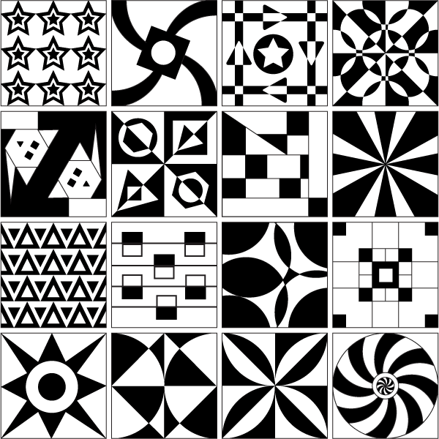

Slide 3
What is Pattern?

Slide 4
Design Patterns
In software engineering, a design pattern is a general repeatable solution to a commonly occurring problem in software design.
Each pattern is like a blueprint that you can customize to solve a particular design problem in your code.

Slide 5
GRASP
General
Responsibility
Assignment
Software
Patterns

Slide 6
GRASP Patterns
The “patterns” provide a representation of nine basic principles that form
a foundation for designing object-oriented systems.
Creator
Information Expert
Low Coupling
Controller
High Cohesion
Polymorphism
Pure Fabrication
Indirection
Protected Variations

Slide 7
Responsibility-Driven Design
Responsibilities of an Object include two types :
Knowing and Doing
Doing responsibilities of an object include
Doing something itself, such as creating and object or doing calculation
Initiating action in other objects
Controlling and coordinating activates in other objects
Knowing responsibilities of an object include
Knowing about private encapsulated data
Knowing about related objects
Knowing about things it can derive

Slide 8
1. Creator Pattern

Slide 9
The Creator
The Creator pattern
Name: Creator
Problem: Who creates an object A?
Solution Assign a class B to create instances of a class A if:
B is a composite of A objects (composition/aggregation)
B contains A objects (contains)
B holds instances of A objects (records)
B closely collaborates with A objects
B has the information needed for creating A objects
Who creates?

Slide 10
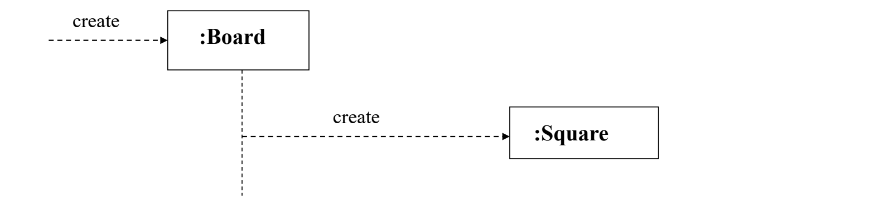
Implementation of creator pattern in POS System
SaleLineItem
SALE
Applying Creator pattern in Static Model
:SaleLineItem
:Sale
Dynamic Model – illustrates Creator Pattern

Slide 11
2. Information Expert

Slide 12
Information Expert pattern
Name: Information Expert
Problem: What is a basic principle by which to assign responsibilities
to an object
Solution: Assign a responsibility to the class that has the information
needed to respond to it.

Slide 13
3. Low Coupling

Slide 14
Low Coupling
One of the the major GRASP principles is Low Coupling.
Coupling is a measure of how strongly one object is connected to, has
knowledge of or depends upon other objects. An object A that calls on the
operations of object B has coupling to B’s services. When object B changes,
object A may be affected.

Slide 15
Low Coupling
Name: Low Coupling
Problem: How to reduce the impact of change?
Solution: Assign responsibilities so that (unnecessary) coupling
remains low. Use this principle to evaluate alternatives.

Slide 16
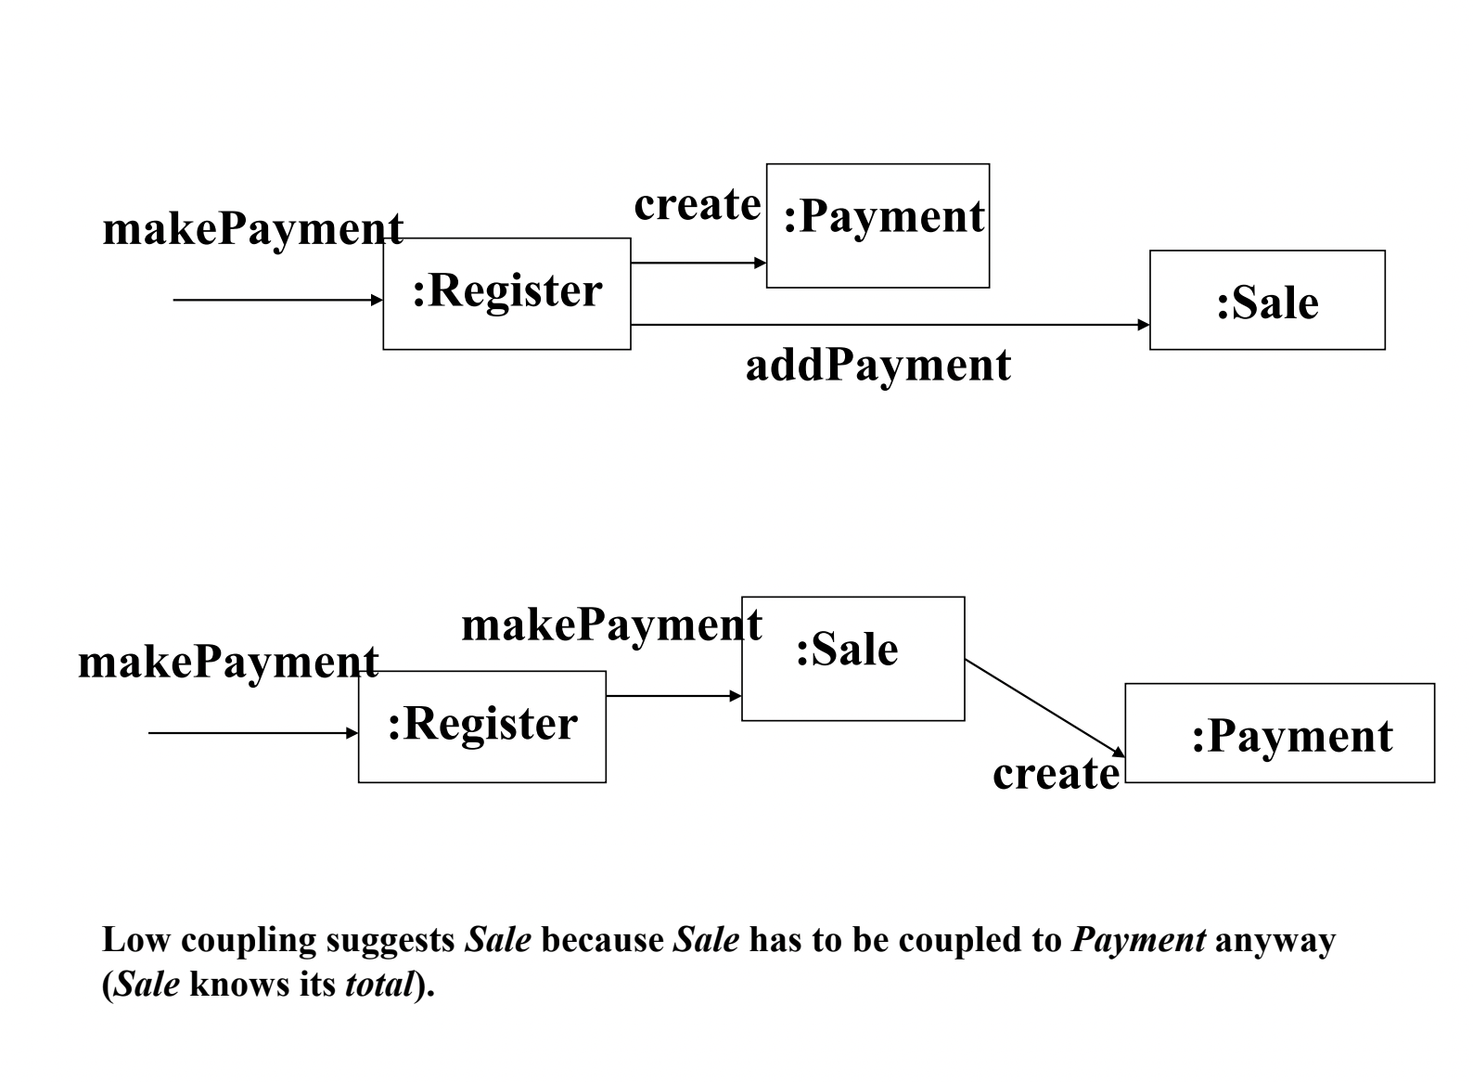

Slide 17
4. High Cohesion

Slide 18
High Cohesion
High Cohesion is an underlying Design Objective
The degree to which all elements of a component are directed towards a single task and all elements directed towards that task are contained in a single component. Internal glue with which component is constructed.
Low Cohesion: A Class is solely responsible for many things in very different
functional areas.
High Cohesion: A class has moderate responsibilities in one functional area and
collaborates with classes to fulfill tasks.

Slide 19
High Cohesion
Name: Low Coupling
Problem: How to reduce the impact of change?
Solution: Assign responsibilities so that (unnecessary) coupling
remains low. Use this principle to evaluate alternatives.

Slide 20
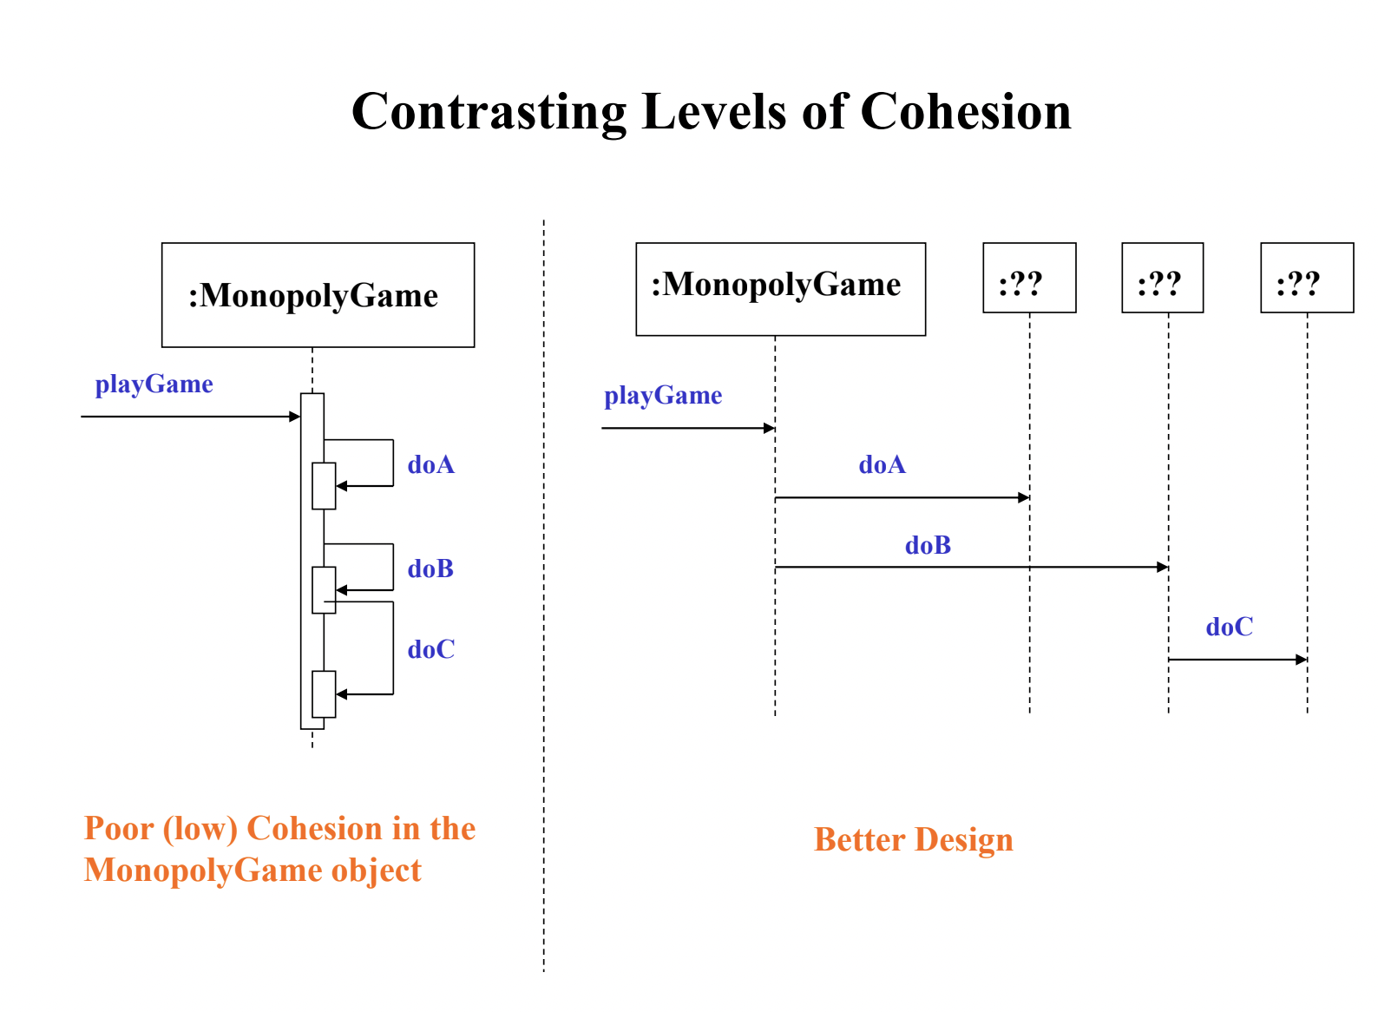

Slide 21
5. Polymorphism

Slide 22
Polymorphism
Problem:
To handle alternatives based on types?
Solution:
When alternate behaviors are selected based on the type of an object, use polymorphic method call to select the behavior, rather than using if statement to test the type.

Slide 23
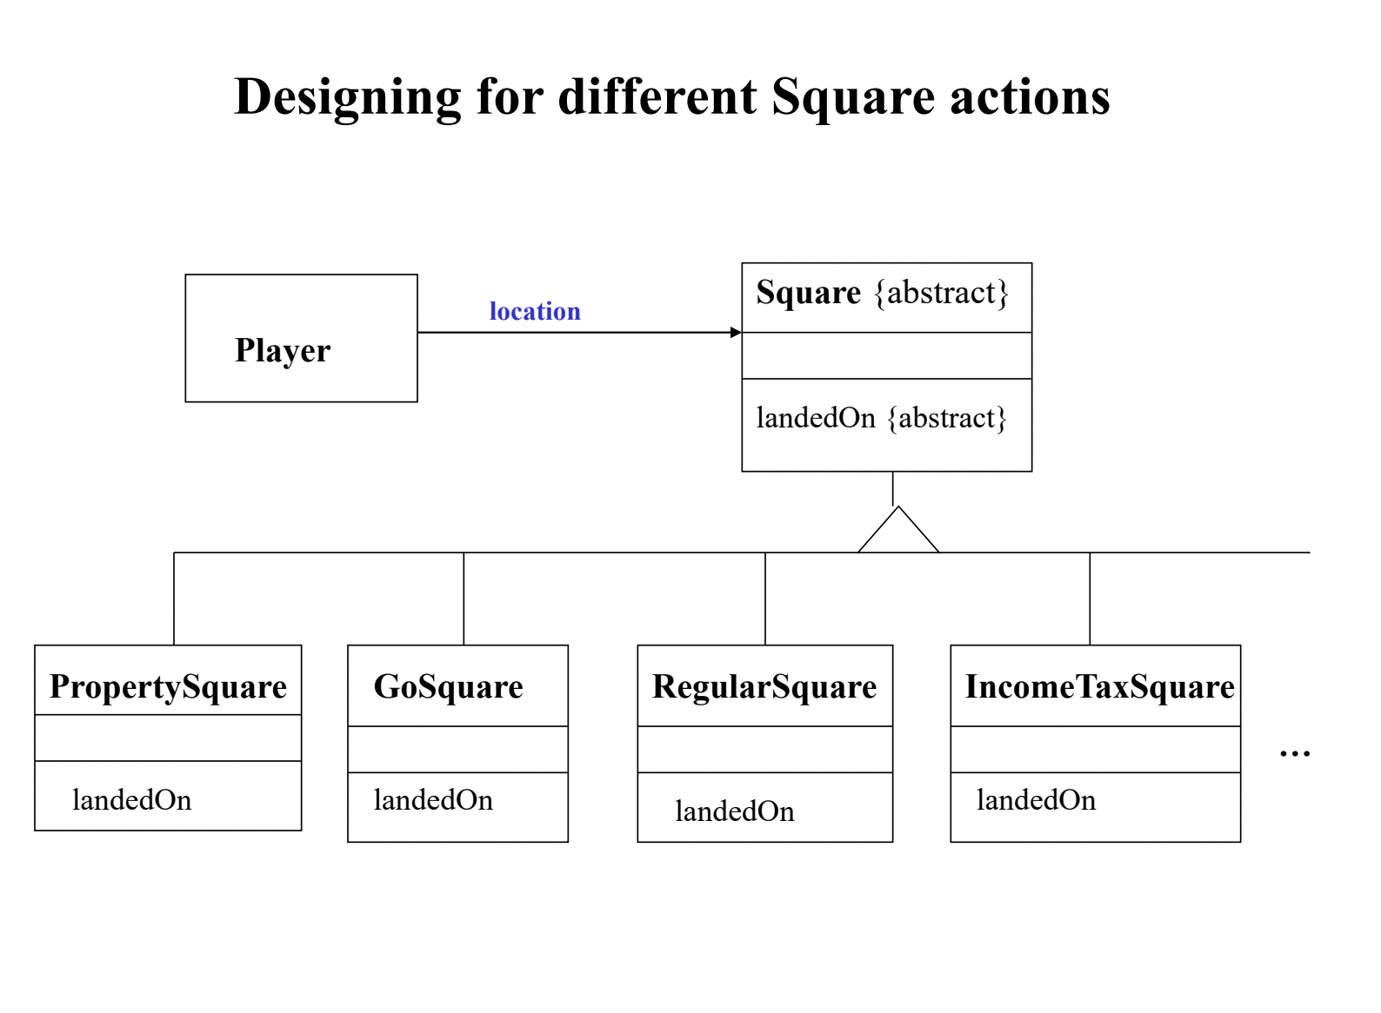

Slide 24
6. Pure Fabrication

Slide 25
Pure Fabrication
Name: Pure Fabrication
Problem: What object should have responsibility when you do not want to violate High Cohesion and Low Coupling, or other goals, but solutions offered by Expert (for example) are not appropriate?
Solution: Assign a highly cohesive set of responsibilities to an artificial or convenience class that does not represent a domain concept.
Example:
Rolling the dice in a Monopoly game – Dice are used in many games
and putting the rolling and summing responsibilities in Player makes it
impossible to generalize this service. Also, it is not now possible to simply ask for the current dice total without rolling again.

Slide 26
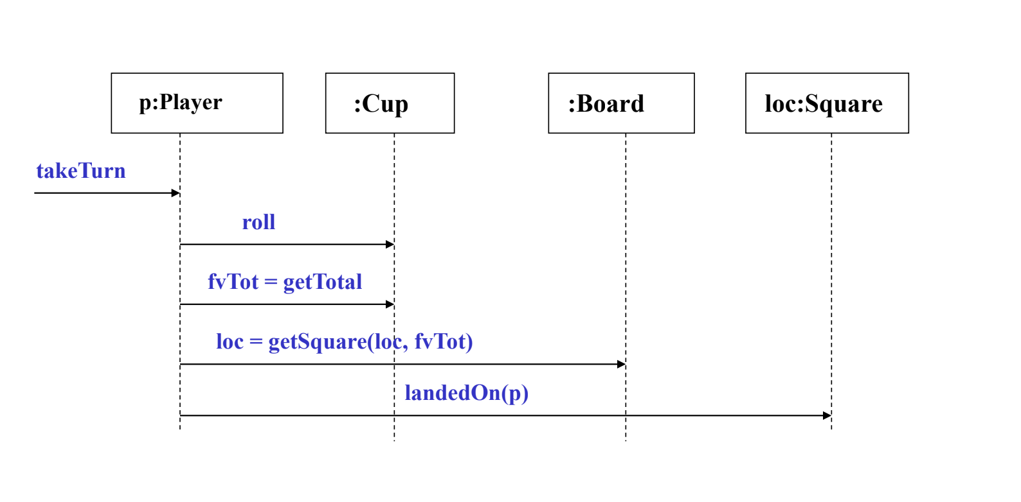
Pure Fabrication
Use a Cup to hold the dice, roll them, and know their total. It can be reused in many
different applications where dice are involved.

Slide 27
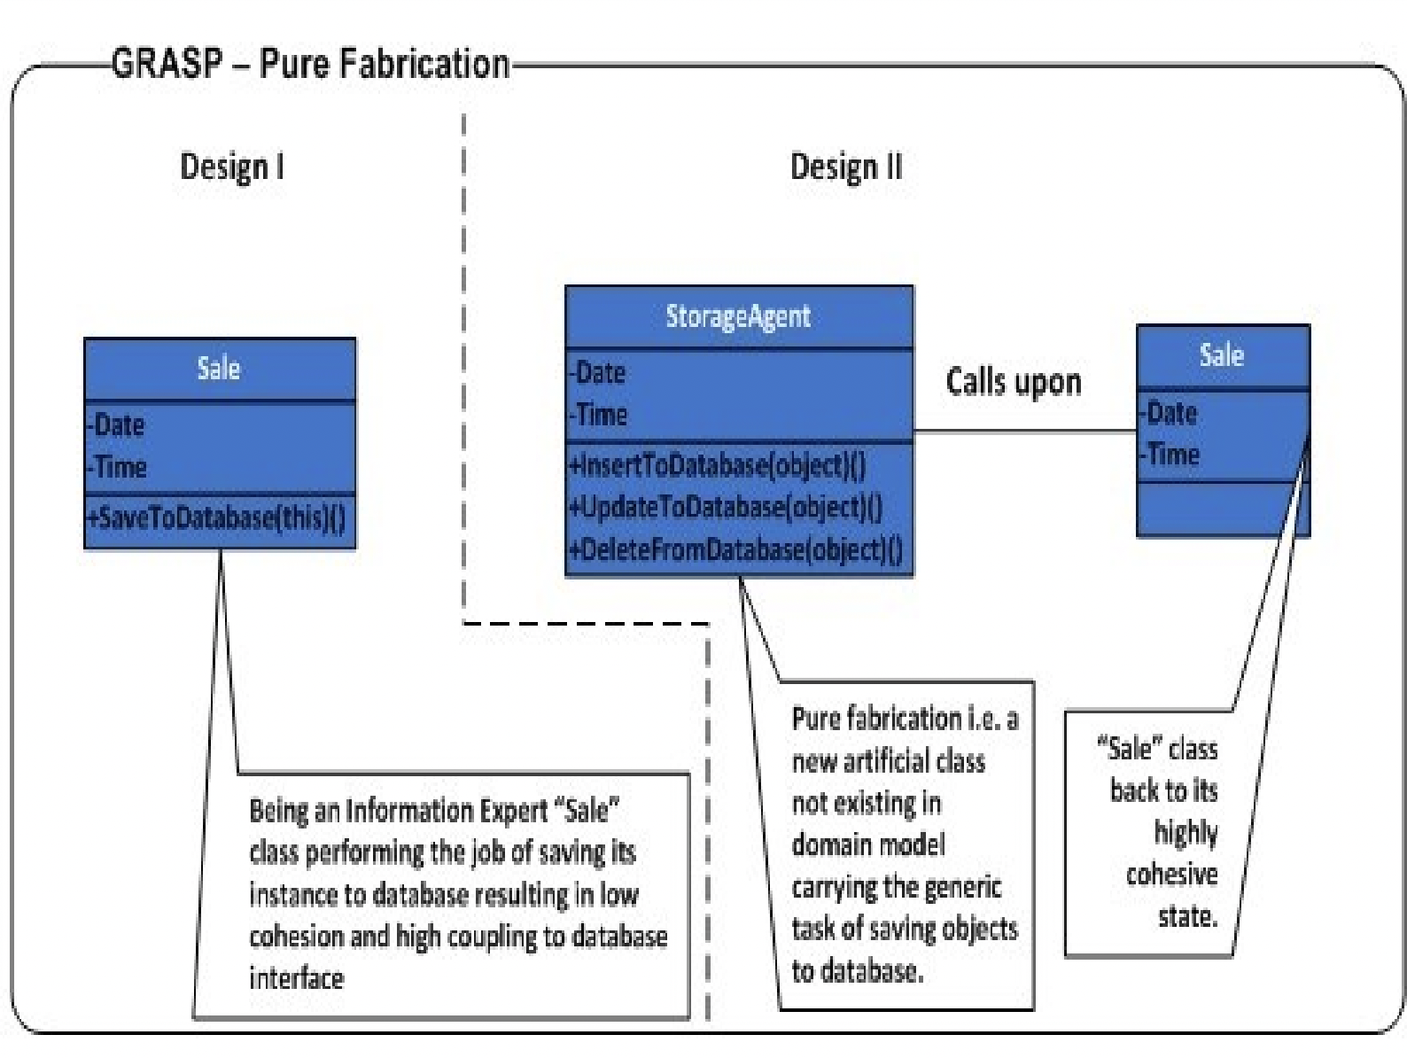

Slide 28
Pure Fabrication
Benefits
High cohesion is supported because responsibilities are factored into a class that only focuses on a very specific set of related tasks.
Reuse potential may be increased because of the presence of fine-grained Pure Fabrication classes.

Slide 29
THANKS

Slide 30
ACKNOWLEDGMENTS
https://refactoring.guru/design-patterns
https://refactoring.guru/design-patterns/history
https://sourcemaking.com/design_patterns

